Slide 1
Uncertainty Quantification for Cyber-Physical Pressurized Water Reactor Experiments
Dr. Taylor K. McKenzie (PI)
Co-authors: Christopher Lamb, Thomas D. Tarman
Notes:
Hello and thank you for listening. I’m Taylor McKenzie and I’ll be talking about our work on performing uncertainty quantification for cyber-physical PWR experiments.

Slide 2
Introduction and Agenda

Slide 3
Introduction
Ph.D. in Economics from University of Oregon in 2017
Joined Sandia National Laboratories in 2017 into Cyber Resilience R&D group
Within group: Developed metrics to assess resilience of cyber-physical systems, performed statistical analyses on cyber emulation experiments, performed risk/resilience/red team studies for specific cyber systems/applications
Matrixing: Interagency Nuclear Safety Review Board/Mars 2020, analyses of economic impact of natural disasters and radiological attacks, risk/reliability analyses of specific (non-cyber) systems
Joined Sandia’s Strategic Futures and Policy Analysis group in March 2020
Conducting and informing mission-enabling policy studies: Telecommuting/hybrid work posture, COVID-19 impacts, chip manufacturing facility cyber risk study
Conducting and informing policy studies: Space infrastructure study (Air Force Office of Scientific Research), public perceptions of nuclear weapons and deterrence (Institute for Public Policy Research and Analysis)
Leading and contributing to studies in Sandia’s Global Futures series: Space Futures, Future of Collective Security, Future of Economic Value and National Security (lead), Future R&D Ecosystems, Future of Arms Control, Future of Knowledge Management (lead)

Slide 4
Introduction
Ph.D. in Economics from University of Oregon in 2017
Studied Industrial Organization, choice modeling, empirical models of competition
Dissertation identified changes in pricing, competition, and technological change in US freight rail industry following deregulation
Joined Sandia National Laboratories in 2017 into Cyber Resilience R&D group
Cyber
Within group: Developed metrics to assess resilience of cyber-physical systems, performed statistical analyses on cyber emulation experiments, performed risk/resilience/red team studies for specific cyber systems/applications
Matrixing: Interagency Nuclear Safety Review Board/Mars 2020, analyses of economic impact of natural disasters and radiological attacks, risk/reliability analyses of specific (non-cyber) systems
Joined Sandia’s Strategic Futures and Policy Analysis group in March 2020
Conducting and informing mission-enabling policy studies: Telecommuting/hybrid work posture, COVID-19 impacts, chip manufacturing facility cyber risk study
Conducting and informing policy studies: Space infrastructure study (Air Force Office of Scientific Research), public perceptions of nuclear weapons and deterrence (Institute for Public Policy Research and Analysis)
Leading and contributing to studies in Sandia’s Global Futures series: Space Futures, Future of Collective Security, Future of Economic Value and National Security (lead), Future R&D Ecosystems, Future of Arms Control, Future of Knowledge Management (lead)

Slide 5
Agenda
Uncertainty quantification for cyber-physical pressurized water reactor experiments (McKenzie et al. 2020) [1]
Introduce and motivate experiments on cyber-physical nuclear power generation systems
Overview of uncertainty quantification and comparison with statistics
Gaussian processes for uncertainty quantification
Specific application and results
Follow-on work and extensions
Gaussian processes in other applications
The inverse problem
Applying the inverse problem to Interagency Nuclear Safety Review Board analyses

Slide 6
Background and System Description

Slide 7
Background
Sandia has significant capabilities in cyber-physical emulation platforms/frameworks
The SCEPTRE platform was developed to “analyze how cyber-initiated events affect the physical world,” using a network emulation with hardware-in-the-loop capabilities to model, test, and validate cyber-physical systems [2]
Used to assess risk and resilience of cyber-physical systems to natural and adversarial disruptions. Systems studied include critical infrastructures (e.g., power, gas, chemical), space/satellite systems, industrial control systems (ICSs).
This project was funded by sponsors from DOE-NE, who were interested in the risk posed to cyber-physical nuclear power generation
Specifically interested in metrics to evaluate risk of catastrophic outcomes given a particular attack scenario
Cyber-physical emulation is particularly well-suited for this analysis
Nuclear reactor mechanics/dynamics are well understood and high-fidelity simulation models exist for these systems
Cyber systems/components are less well-understood and more difficult to simulate with needed fidelity, so those components are emulated

Slide 8
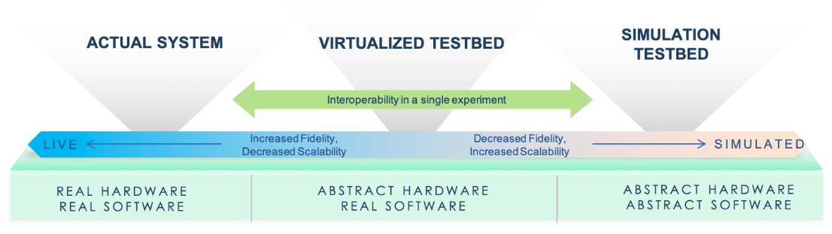
Emulation and Cyber Experiments
We want to evaluate how a critical system would respond to a given disruption
Quantify impacts
Identify and quantify effectiveness of mitigation strategies
Affecting operations of a critical system is infeasible
Emulation provides ability to create a sufficient representation of a system, including hardware in the loop
Emulation can be used to see how actual system would respond without affecting operations
Parameters of the system, emulation, or disruption may be uncertain
Thus, outcomes are also uncertain and can be described by a distribution
Uncertainty quantification (UQ) involves propagating input uncertainty to determine/approximate the distribution of outcomes
Notes:
In this research, we consider how a critical system would respond to a given disruption. This is a valuable exercise because it allows to determine what impacts a system might experience due to a disruption and investigate mitigation strategies.
Of course, since we’re considering a critical system, we can’t do anything that might affect operations of that system. We utilize emulation, which gives us the ability to create a sufficient representation of the system, potentially including hardware in the loop, that can be used to see how the actual system would respond without affecting operations.
When assessing impacts, we note that parameters of the system, emulation, or disruption may be uncertain. That uncertainty propagates through to outcomes, meaning impacts are also uncertain. Thus, our goal is to quantify the distribution of impacts given the distribution of inputs, which is an exercise in uncertainty quantification.
*****
This could be a good place to begin motivating (here’s why we use cyber experiments + emulation, here’s what output from emulation looks like and how its used, here’s why we need uncertainty quantification/continuous distribution/Bayesian methods. Show that each piece of the analysis was intentionally-driven.

Slide 9
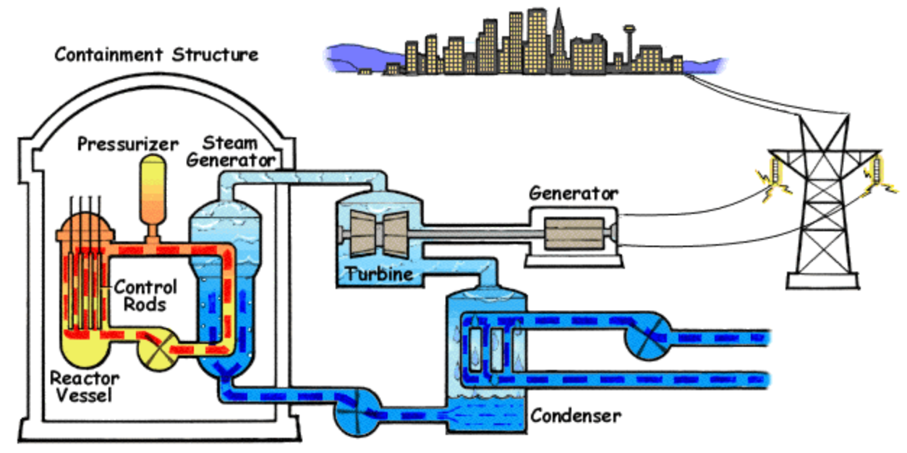
Proof of Concept System: Pressurized Water Reactor
Image sources: NRC, Wikipedia

Slide 10
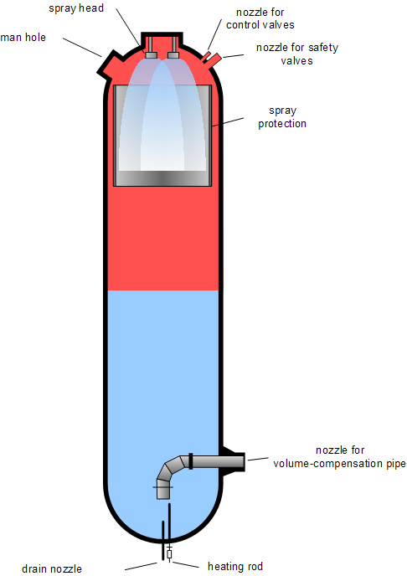
Proof of Concept System: Pressurized Water Reactor
Image sources: NRC, Wikipedia

Slide 11
Proof of Concept System: Pressurized Water Reactor
Pressurized water reactors (PWRs) are a nuclear reactor design with the following characteristics:
Two coolant loops:
Primary loop where coolant cools and moderates the reactor
Secondary loop where coolant is heated by the primary and generates steam that drives turbines
Pressurized primary reactor loop, which allows coolant to reach high temperatures while remaining liquid
Typical pressure: ~15-16 MPa
Typical temperature: ~345 °C
In a dual coolant loop design, only coolant in the primary loop requires significant radioactive containment
Pressurizer sits on the primary coolant loop and maintains appropriate pressure
Too high could damage vessels/pipes/components. Too low could allow water to flash to steam.
Electric heaters increase temperature/pressure of pressurizer, water sprayers reduce temperature/pressure
Pressurizer is a critical component of the system, and failures are highly consequential
Dual loop design is unique to PWRs, motivating risk analysis specific to PWRs
PWRs are a very common design, accounting for 65% of nuclear power generation in the U.S. in 2021 [3]

Slide 12
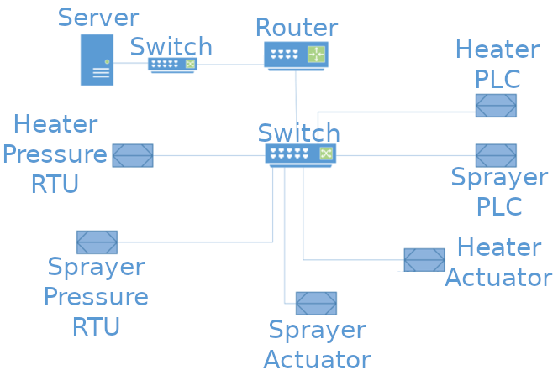
Proof of Concept System: Cyber-Physical PWR System
We draw on a cyber-physical emulation of a PWR system
Abstract hardware: Pressurizer (including electric variable heaters and spray valves to control pressure) described by numerical model implemented in Simulink
Real software: Supervisory control and data acquisition (SCADA) system, including server, router, network switches, remote terminal units (RTUs) to interface with pressure sensors, and programmable logic controllers (PLCs) to actuate heaters/sprayers
Notes:
SCADA system includes virtualized hardware components, but those components are speaking to each other/using the same protocols as real components

Slide 13
Research Problem and Uncertainty Quantification Approach

Slide 14
Research Problem
In general, previous risk/resilience analyses, red team assessments, and intelligence can be used to form a distribution of disruptions/attacks
For this analysis, attacks will continually inject a specified control value to the pressurizer heater and/or sprayer. The injected values and which component(s) are targeted is assumed to be random.
Given a distribution of attacks, our goal is to estimate the probability that a catastrophic outcome will occur
Severe consequences can occur if differential pressure on the pressurizer exceeds 1 MPa
Emulation models for generic PWR systems were developed for previous projects. Those could be used to estimate failure probability using Monte Carlo methods.
However, emulation is computationally expensive, making it infeasible to estimate probability of failure probability with acceptable level of uncertainty
Need to use methods that can accommodate limited numbers of observations and correctly express uncertainty
Uncertainty quantification (UQ) methods can be used to estimate outcomes and evaluate uncertainty in those estimates when obtaining additional observations is expensive

Slide 15
Disruption and Quantities of Interest
Disruption:
An attacker is assumed to have gained access to the SCADA network and is able to (temporarily) override control values being fed to the heater and/or sprayer
The SCADA network is assumed to not have any intrusion detection or mitigation system, so the attacker is free to generate network traffic with no risk of being discovered/stopped
The attacker is assumed to target either heater, sprayer, or both, each with probability 1/3
The attacker continuously injects false values to targeted actuator(s) for two minutes. Injected values are constant over the attack and are assumed to be uniformly distributed over [0, 100].
Notes:
For the disruption, we assume an attacker has exploited a vulnerability in the system and targets either the heater actuator, sprayer actuators, or both actuators, each with probability 1/3. The attacker will then continuously inject false values to the targeted actuators for two minutes. The injected values are constant over the course of the attack and are distributed uniformly on the range from zero to 100.
Thus, the inputs to the emulation are which actuator is targeted and what values are injected to the targeted actuators.
Next, severe consequences can occur if differential pressure of the heater or sprayer exceeds one mega-Pascal.
We focus on estimating the probability that differential pressure will exceed one mega-Pascal at any point during the two minute attack, conditional on which actuator is targeted and values injected to the targeted actuators.
Inputs used to fit the Gaussian process were generated with Latin hypercube sampling, the emulation was run with those inputs, and outcomes were recorded to use in fitting the Gaussian process.
The standard Gaussian process model, which ordinarily describes real-valued outcomes, was adapted to describe binary outcomes. The Gaussian process was fit using the Stan platform, using 1000 warmup iterations and 1000 sampling iterations.

Slide 16
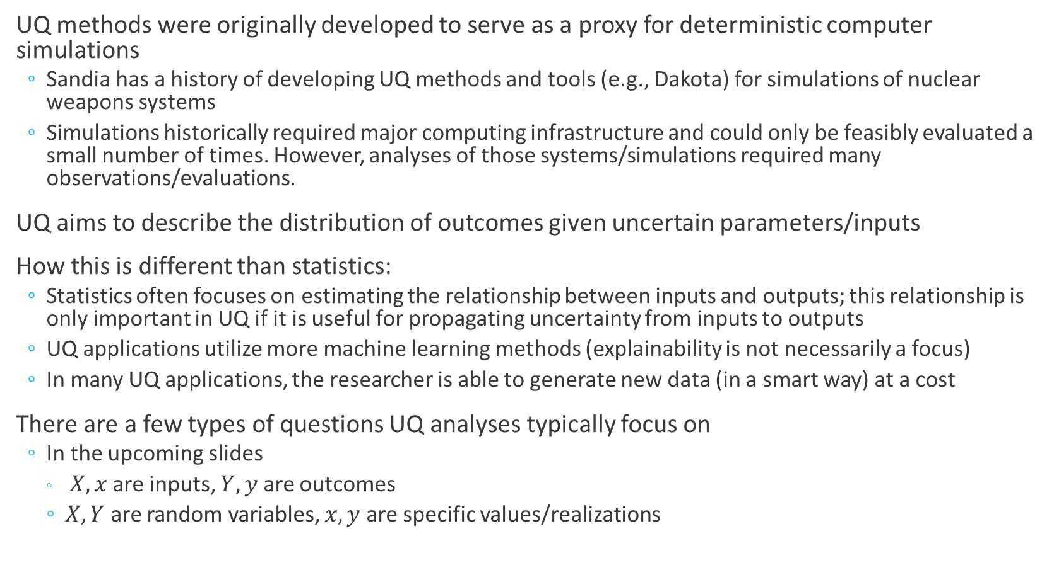
UQ vs. Statistics
UQ methods were originally developed to serve as a proxy for deterministic computer simulations
Sandia has a history of developing UQ methods and tools (e.g., Dakota) for simulations of nuclear weapons systems
Simulations historically required major computing infrastructure and could only be feasibly evaluated a small number of times. However, analyses of those systems/simulations required many observations/evaluations.
UQ aims to describe the distribution of outcomes given uncertain parameters/inputs
How this is different than statistics:
Statistics often focuses on estimating the relationship between inputs and outputs; this relationship is only important in UQ if it is useful for propagating uncertainty from inputs to outputs
UQ applications utilize more machine learning methods (explainability is not necessarily a focus)
In many UQ applications, the researcher is able to generate new data (in a smart way) at a cost
There are a few types of questions UQ analyses typically focus on
In the upcoming slides
$X,x$ are inputs, $Y,y$ are outcomes
$X, Y$ are random variables, $x, y$ are specific values/realizations

Slide 17
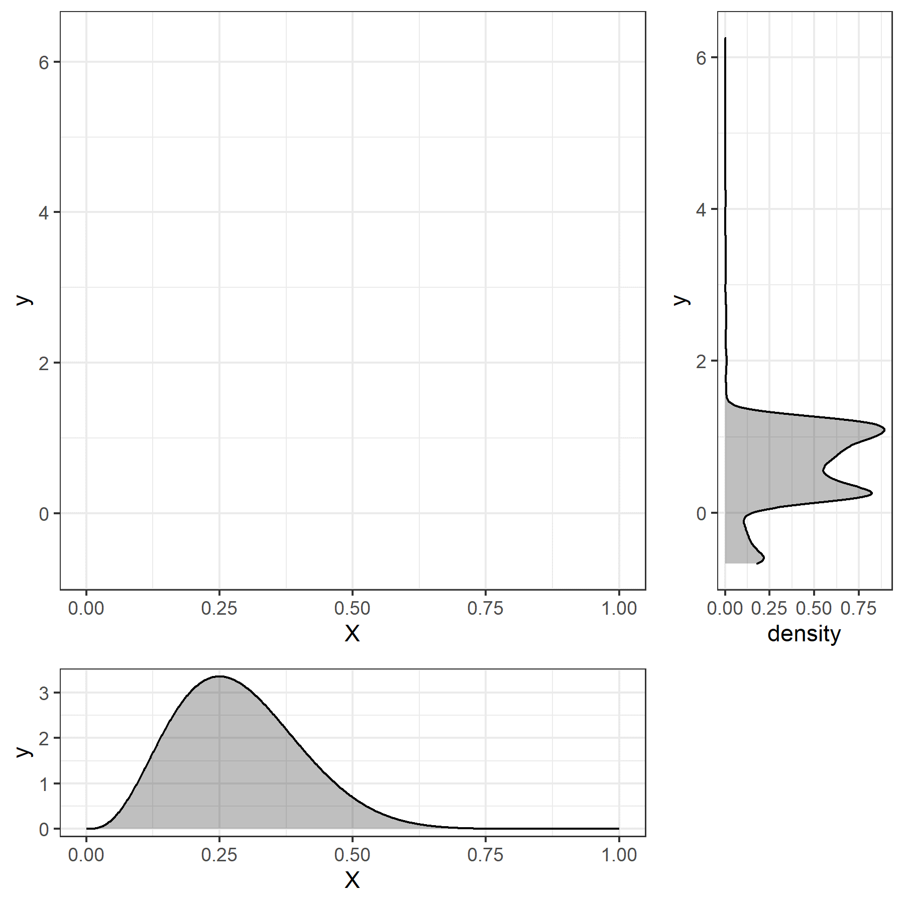
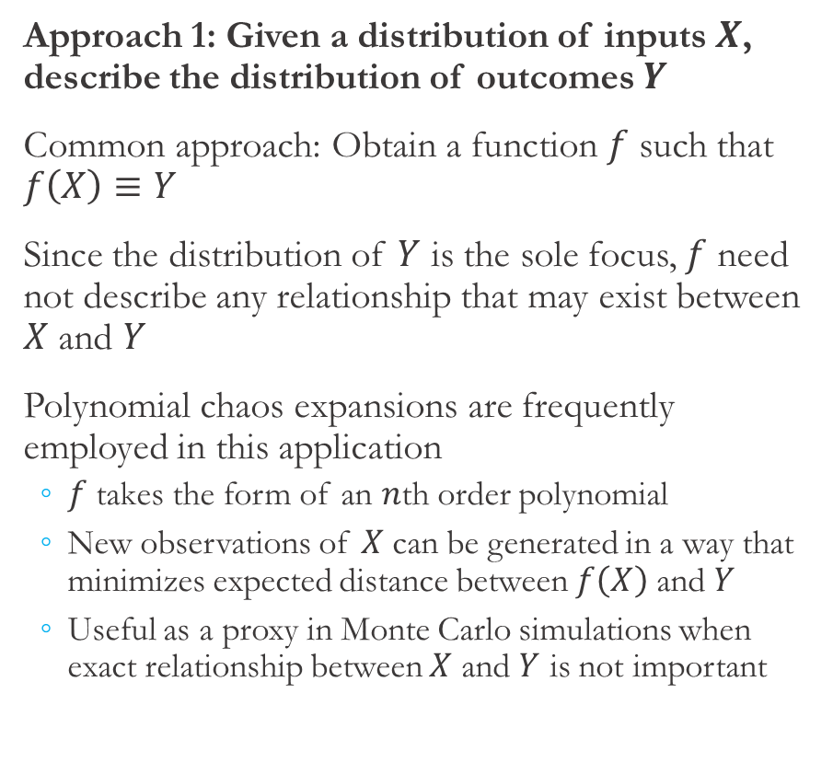
UQ Applications (1)
Approach 1: Given a distribution of inputs $X$, describe the distribution of outcomes $Y$
Common approach: Obtain a function $f$ such that $f\left(X\right)≡Y$
Since the distribution of $Y$ is the sole focus, $f$ need not describe any relationship that may exist between $X$ and $Y$
Polynomial chaos expansions are frequently employed in this application
$f$ takes the form of an $n$th order polynomial
New observations of $X$ can be generated in a way that minimizes expected distance between $f\left(X\right)$ and $Y$
Useful as a proxy in Monte Carlo simulations when exact relationship between $X$ and $Y$ is not important

Slide 18
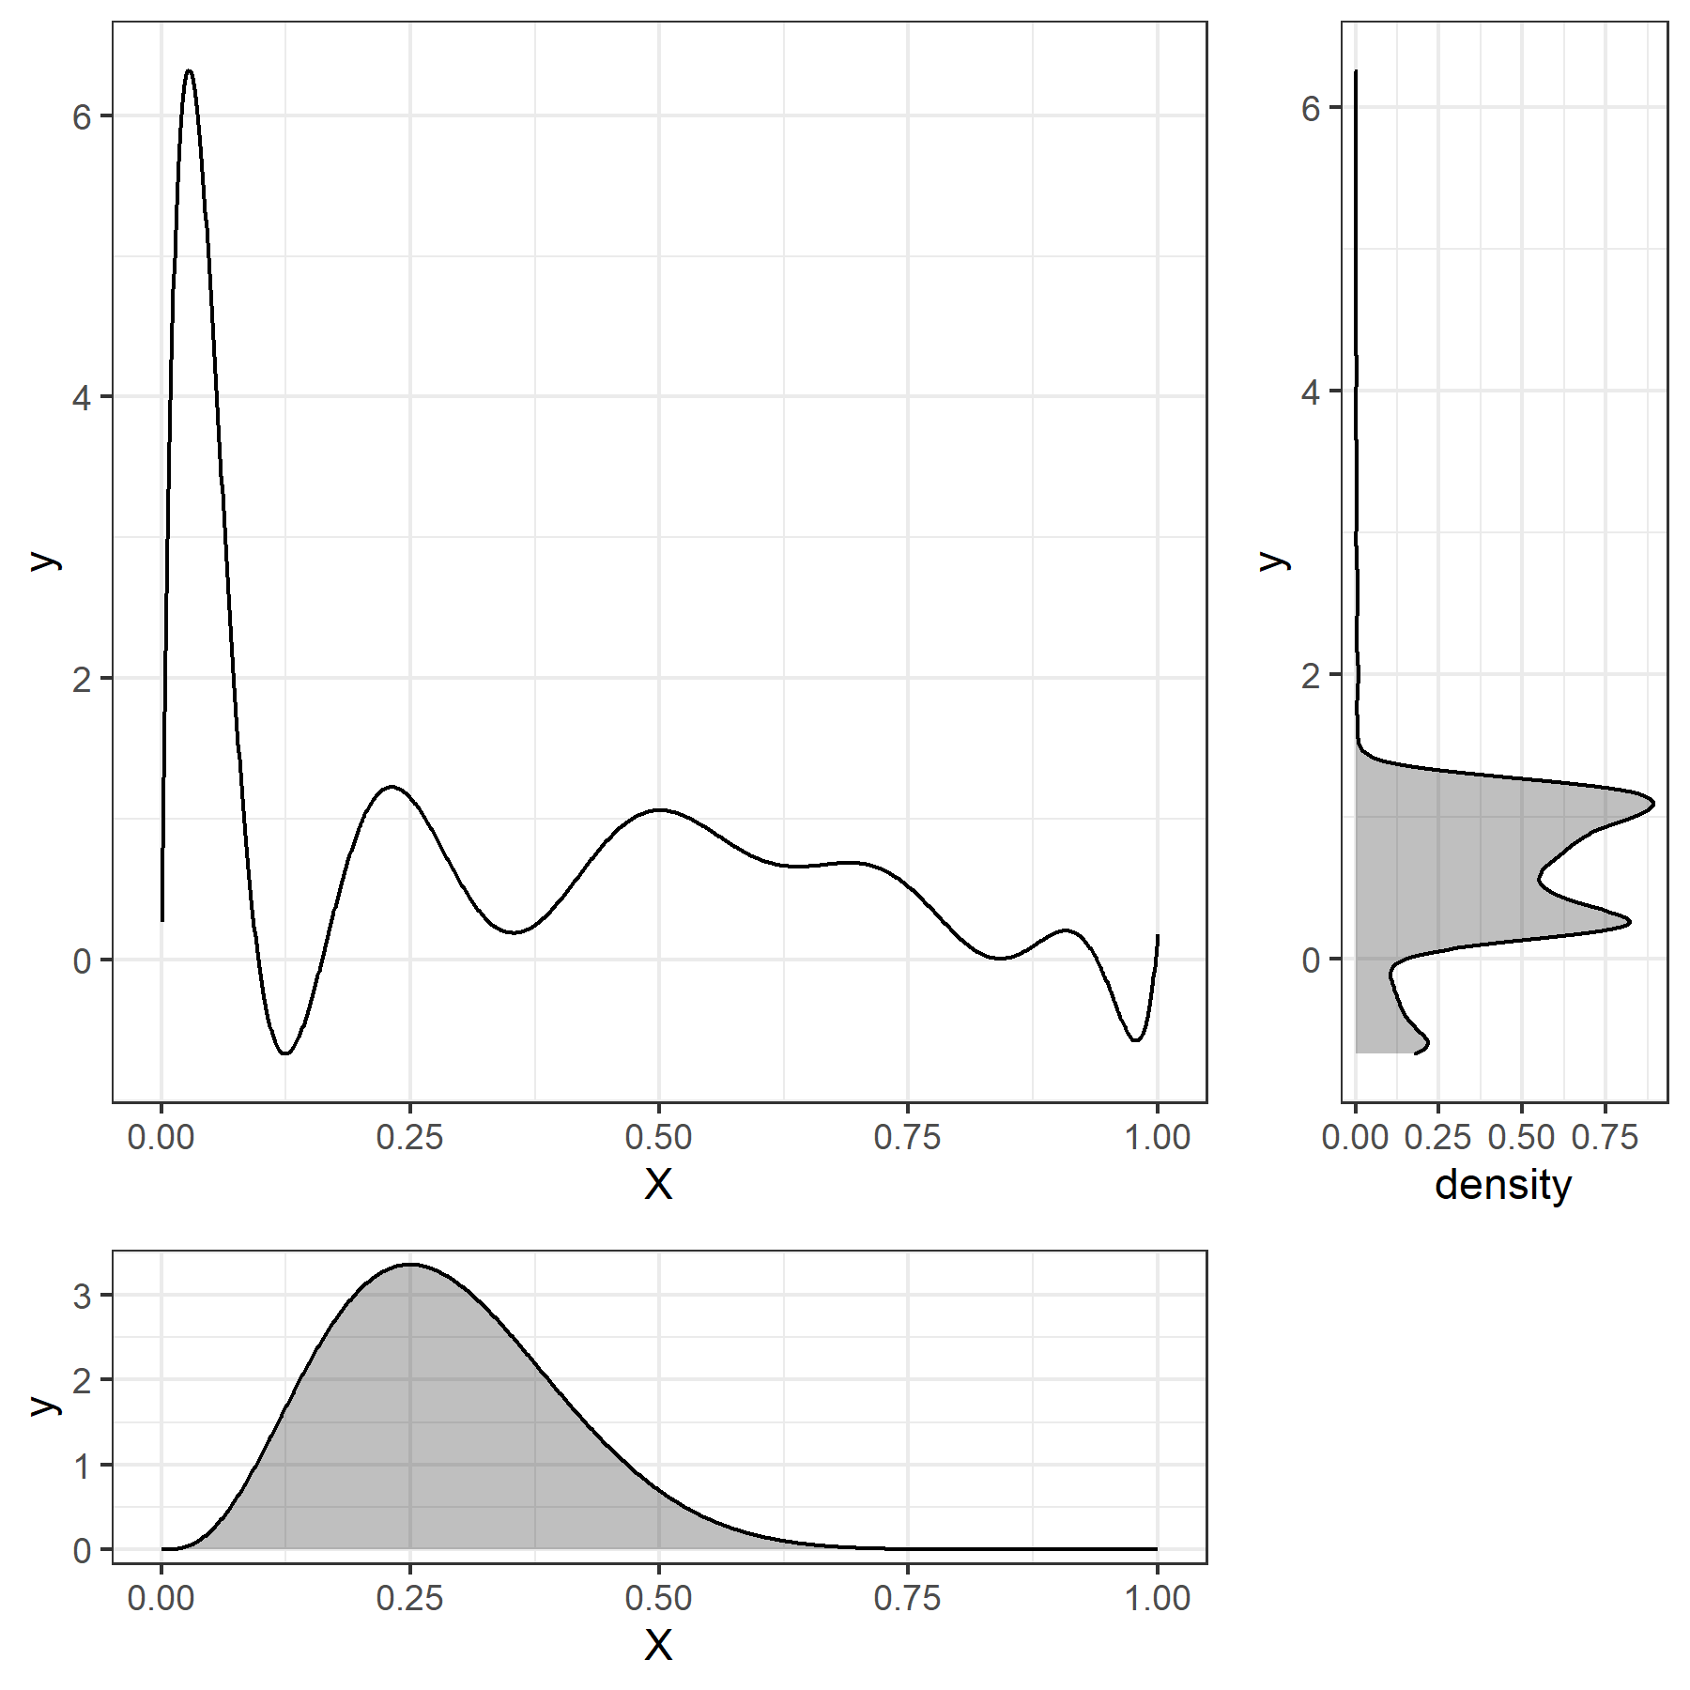
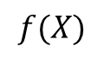
UQ Applications (1)
Approach 1: Given a distribution of inputs $X$, describe the distribution of outcomes $Y$
Common approach: Obtain a function $f$ such that $f\left(X\right)≡Y$
Since the distribution of $Y$ is the sole focus, $f$ need not describe any relationship that may exist between $X$ and $Y$
Polynomial chaos expansions are frequently employed in this application
$f$ takes the form of an $n$th order polynomial
New observations of $X$ can be generated in a way that minimizes expected distance between $f\left(X\right)$ and $Y$
Useful as a proxy in Monte Carlo simulations when exact relationship between $X$ and $Y$ is not important
$$f(X)$$

Slide 19
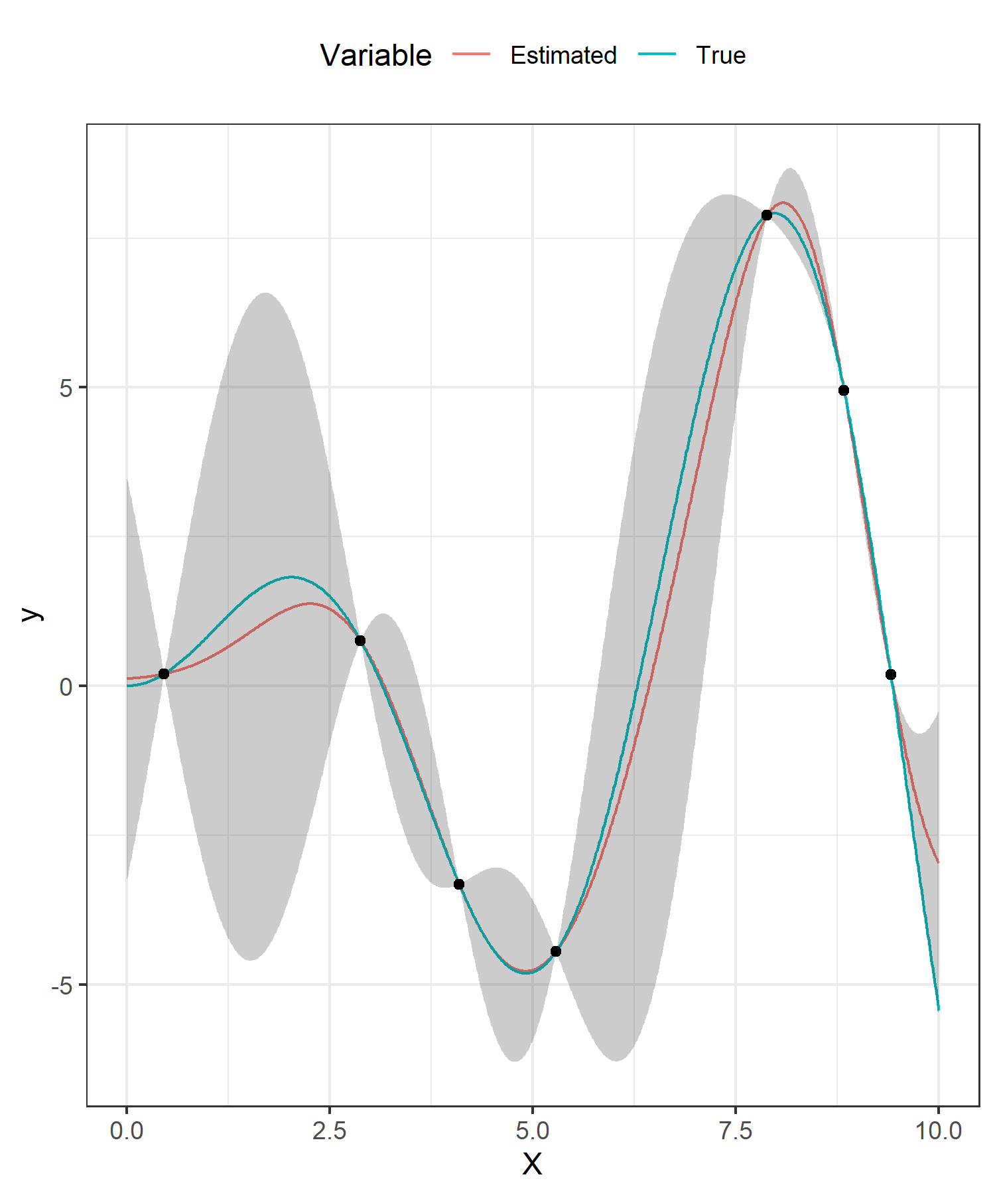
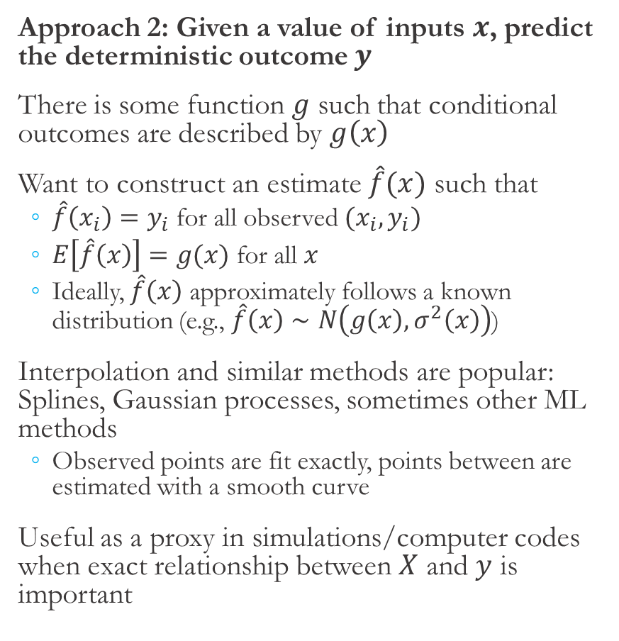
UQ Applications (2)
Approach 2: Given a value of inputs $x$, predict the deterministic outcome $y$
There is some function $g$ such that conditional outcomes are described by $g\left(x\right)$
Want to construct an estimate $\hat{f}(x)$ such that
$\hat{f}\left(x_{i}\right)=y_{i}$ for all observed $(x_{i},y_{i})$
$E\left[\hat{f}\left(x\right)\right]=g(x)$ for all $x$
Ideally, $\hat{f}\left(x\right)$ approximately follows a known distribution (e.g., $\hat{f}\left(x\right)∼N\left(g\left(x\right), σ^{2}\left(x\right)\right)$)
Interpolation and similar methods are popular: Splines, Gaussian processes, sometimes other ML methods
Observed points are fit exactly, points between are estimated with a smooth curve
Useful as a proxy in simulations/computer codes when exact relationship between $X$ and $y$ is important

Slide 20
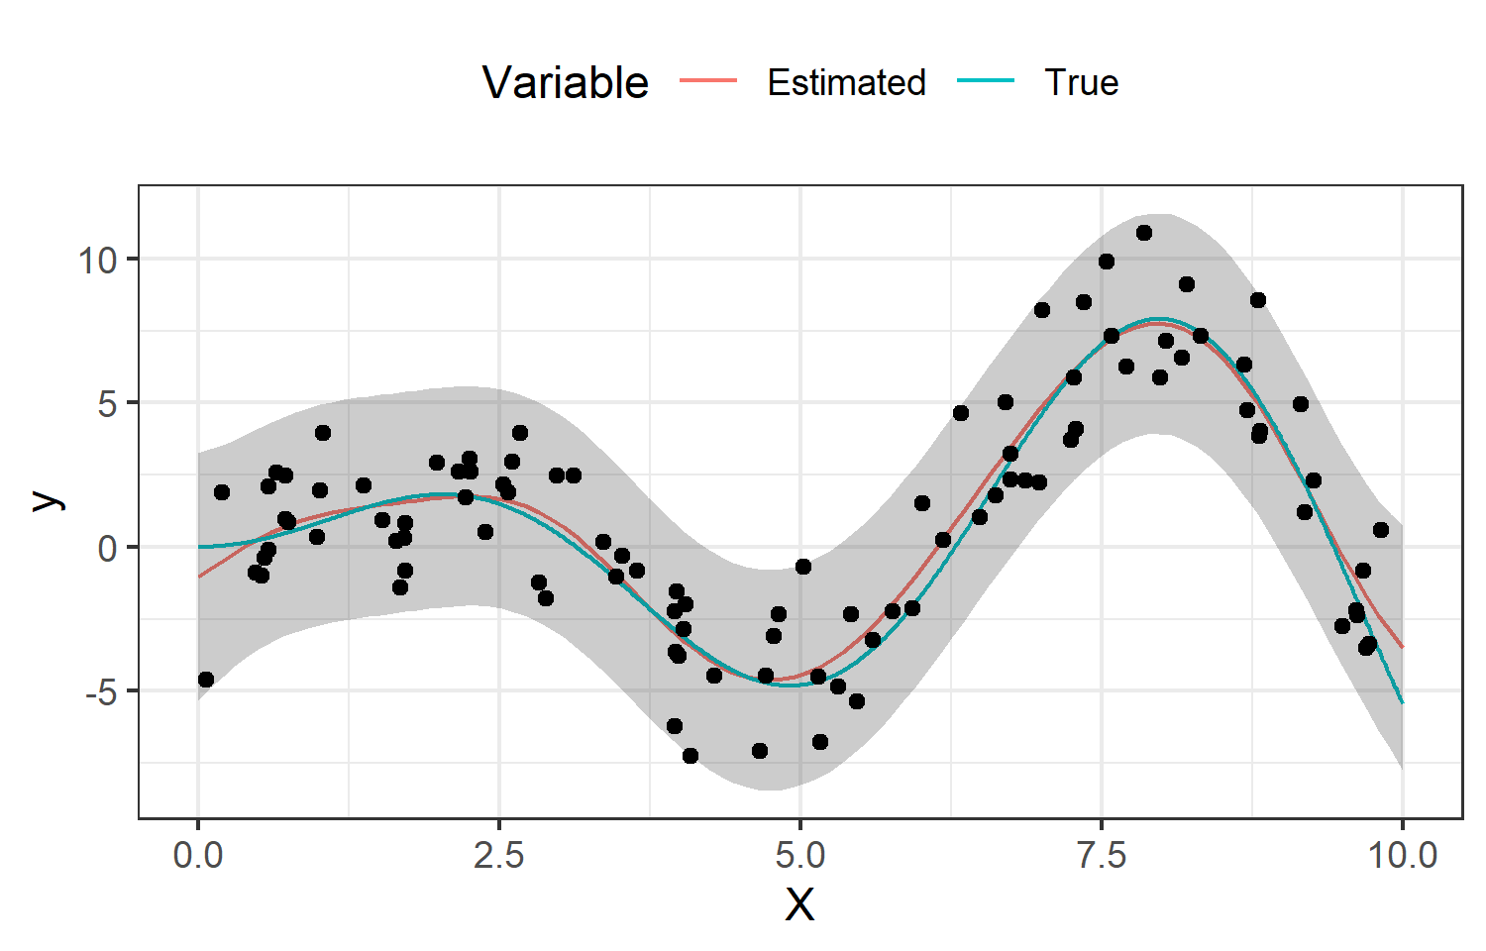
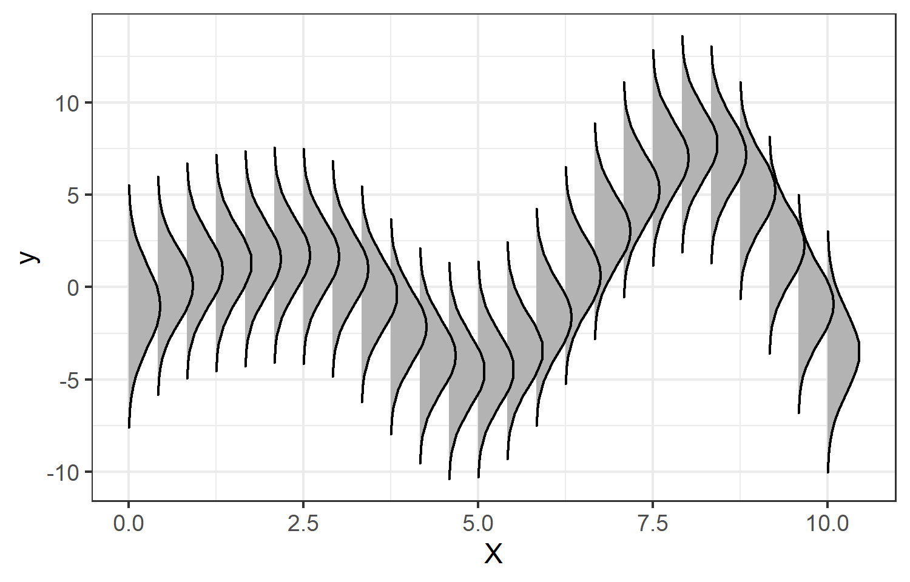
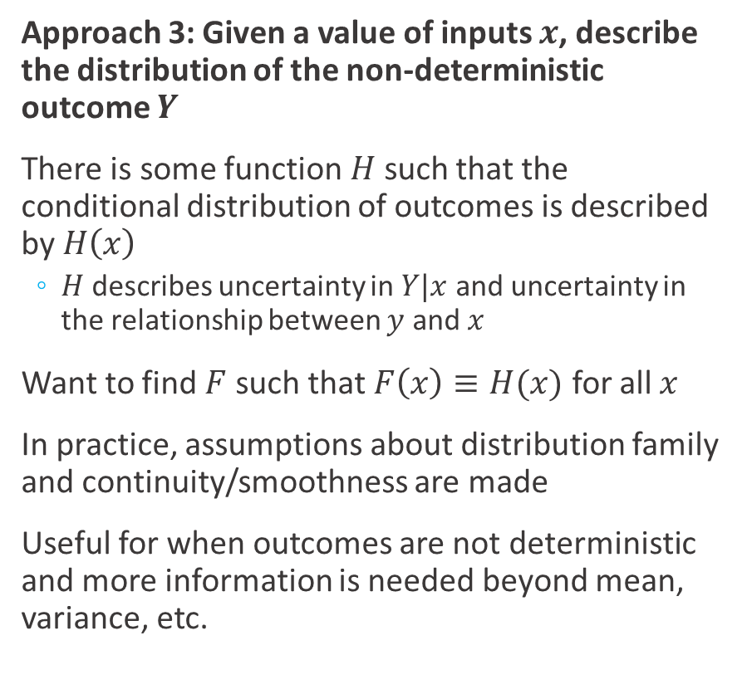
UQ Applications (3)
Approach 3: Given a value of inputs $x$, describe the distribution of the non-deterministic outcome $Y$
There is some function $H$ such that the conditional distribution of outcomes is described by $H\left(x\right)$
$H$ describes uncertainty in $Y|x$ and uncertainty in the relationship between $y$ and $x$
Want to find $F$ such that $F\left(x\right)≡H(x)$ for all $x$
In practice, assumptions about distribution family and continuity/smoothness are made
Useful for when outcomes are not deterministic and more information is needed beyond mean, variance, etc.

Slide 21
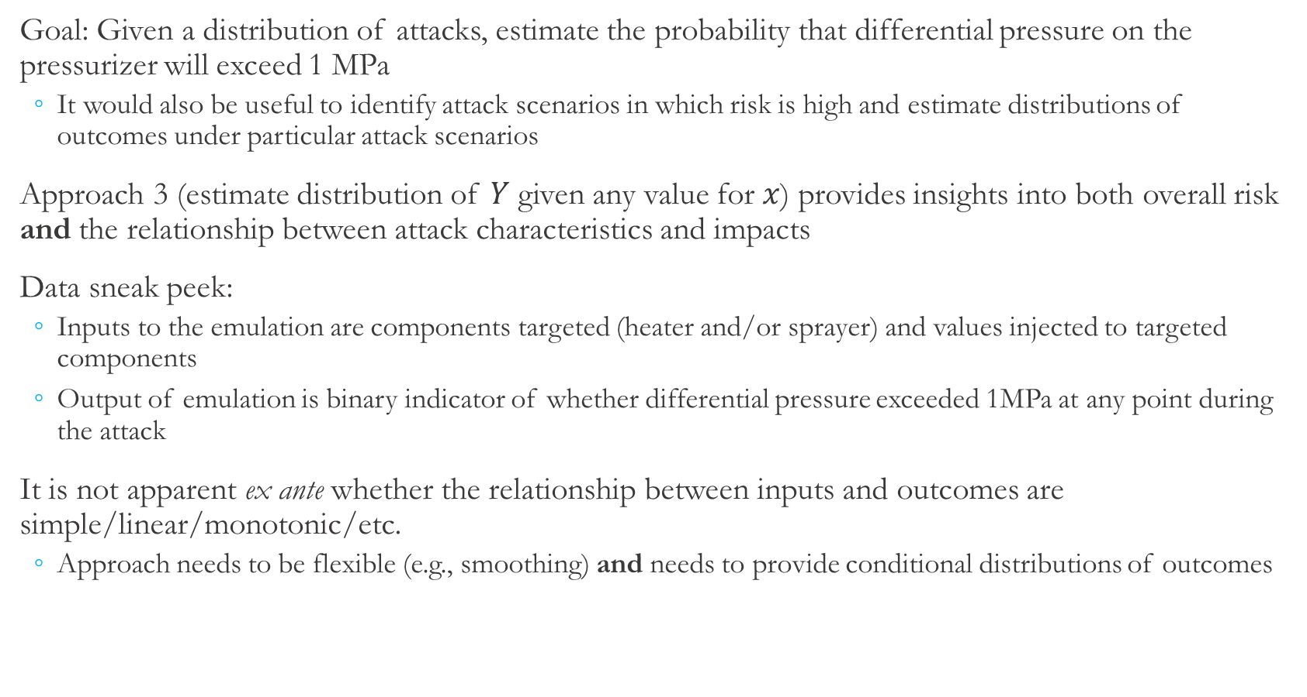
Research Objective and General Approach
Goal: Given a distribution of attacks, estimate the probability that differential pressure on the pressurizer will exceed 1 MPa
It would also be useful to identify attack scenarios in which risk is high and estimate distributions of outcomes under particular attack scenarios
Approach 3 (estimate distribution of $Y$ given any value for $x$) provides insights into both overall risk and the relationship between attack characteristics and impacts
Data sneak peek:
Inputs to the emulation are components targeted (heater and/or sprayer) and values injected to targeted components
Output of emulation is binary indicator of whether differential pressure exceeded 1MPa at any point during the attack
It is not apparent ex ante whether the relationship between inputs and outcomes are simple/linear/monotonic/etc.
Approach needs to be flexible (e.g., smoothing) and needs to provide conditional distributions of outcomes
Notes:
Use this slide to explain why goal 3 is appropriate. Need to explain why it’s useful to have a continuum of distributions for this application.
Could also explain why GPs here…
Sneak peek into data could be useful here… Understand that inputs are distribution of values attacker is injecting to heater/sprayer and outcome is (uncertain) event that differential pressure exceeds 1 MPa given those value.
Goal 3 allows for identification of relationships between values injected and probability of consequence as well as overall understanding of probability of consequence.
Outcome is binary, and it’s not clear whether there is a simple/linear/monotonic relationship with outcome/odds. So, need some kind of nonlinear data-driven model; something like kernel smoothers are one appropriate approach.

Slide 22
Kernel Smoothing and Gaussian Process Approaches

Slide 23
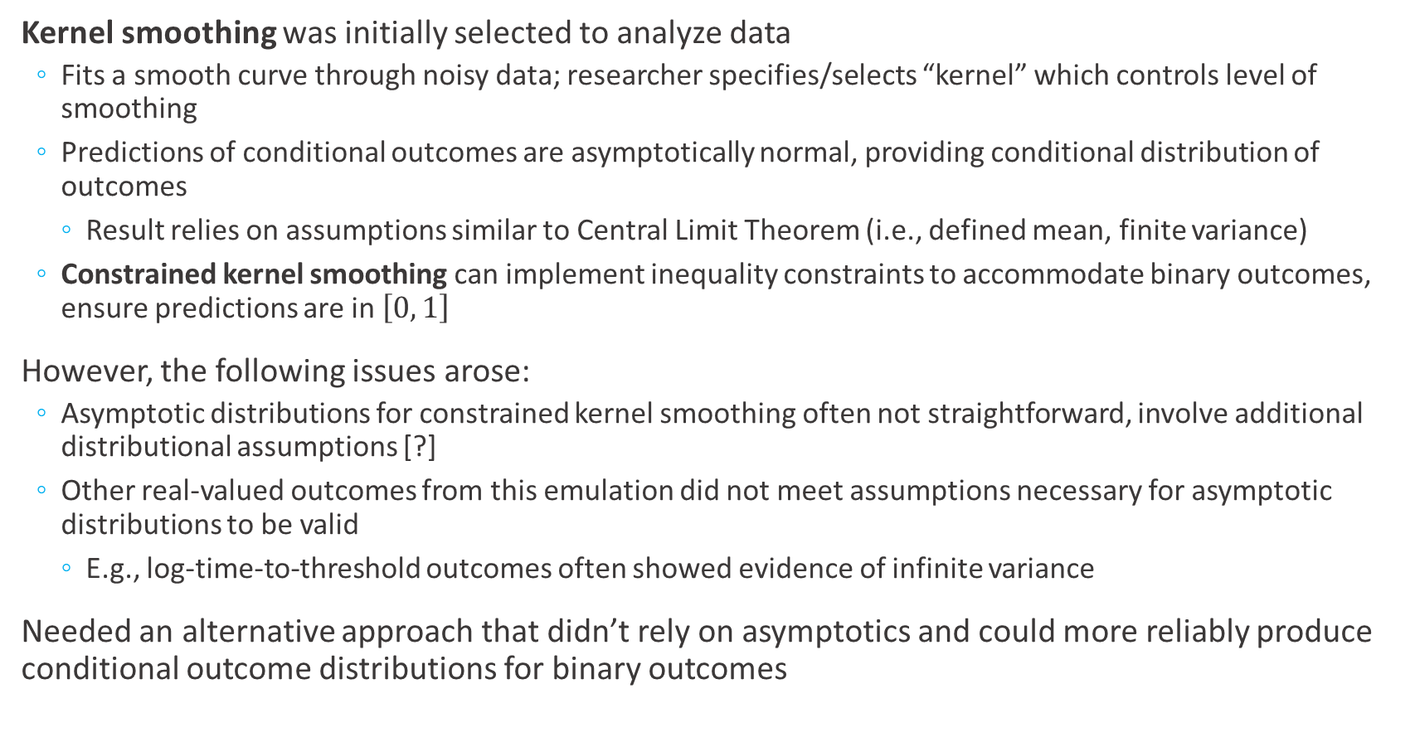
A Failed Approach and Lessons Learned
Kernel smoothing was initially selected to analyze data
Fits a smooth curve through noisy data; researcher specifies/selects “kernel” which controls level of smoothing
Predictions of conditional outcomes are asymptotically normal, providing conditional distribution of outcomes
Result relies on assumptions similar to Central Limit Theorem (i.e., defined mean, finite variance)
Constrained kernel smoothing can implement inequality constraints to accommodate binary outcomes, ensure predictions are in $\left[0, 1\right]$
However, the following issues arose:
Asymptotic distributions for constrained kernel smoothing often not straightforward, involve additional distributional assumptions [?]
Other real-valued outcomes from this emulation did not meet assumptions necessary for asymptotic distributions to be valid
E.g., log-time-to-threshold outcomes often showed evidence of infinite variance
Needed an alternative approach that didn’t rely on asymptotics and could more reliably produce conditional outcome distributions for binary outcomes

Slide 24
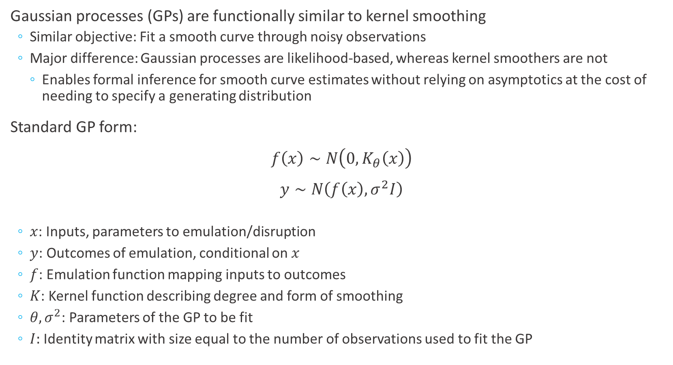
Gaussian Processes
Gaussian processes (GPs) are functionally similar to kernel smoothing
Similar objective: Fit a smooth curve through noisy observations
Major difference: Gaussian processes are likelihood-based, whereas kernel smoothers are not
Enables formal inference for smooth curve estimates without relying on asymptotics at the cost of needing to specify a generating distribution
Standard GP form:
$f\left(x\right)∼N\left(0,K_{θ}\left(x\right)\right)$
$y∼N\left(f\left(x\right), σ^{2}I\right)$
$x$: Inputs, parameters to emulation/disruption
$y$: Outcomes of emulation, conditional on $x$
$f$: Emulation function mapping inputs to outcomes
$K$: Kernel function describing degree and form of smoothing
$θ,σ^{2}$: Parameters of the GP to be fit
$I:$ Identity matrix with size equal to the number of observations used to fit the GP
GP details
Notes:
Need some motivation somewhere (maybe not here) for using Bayesian/simulation methods. Difficulty of propagating uncertainty in parameter estimates to uncertainty in predictions. Parameter instability issues in generalized GPs like Bernoulli models (esp. applicable here). Assumptions for asymptotics are not necessarily met, issues with doing asymptotics with Bernoulli outcome.

Slide 25
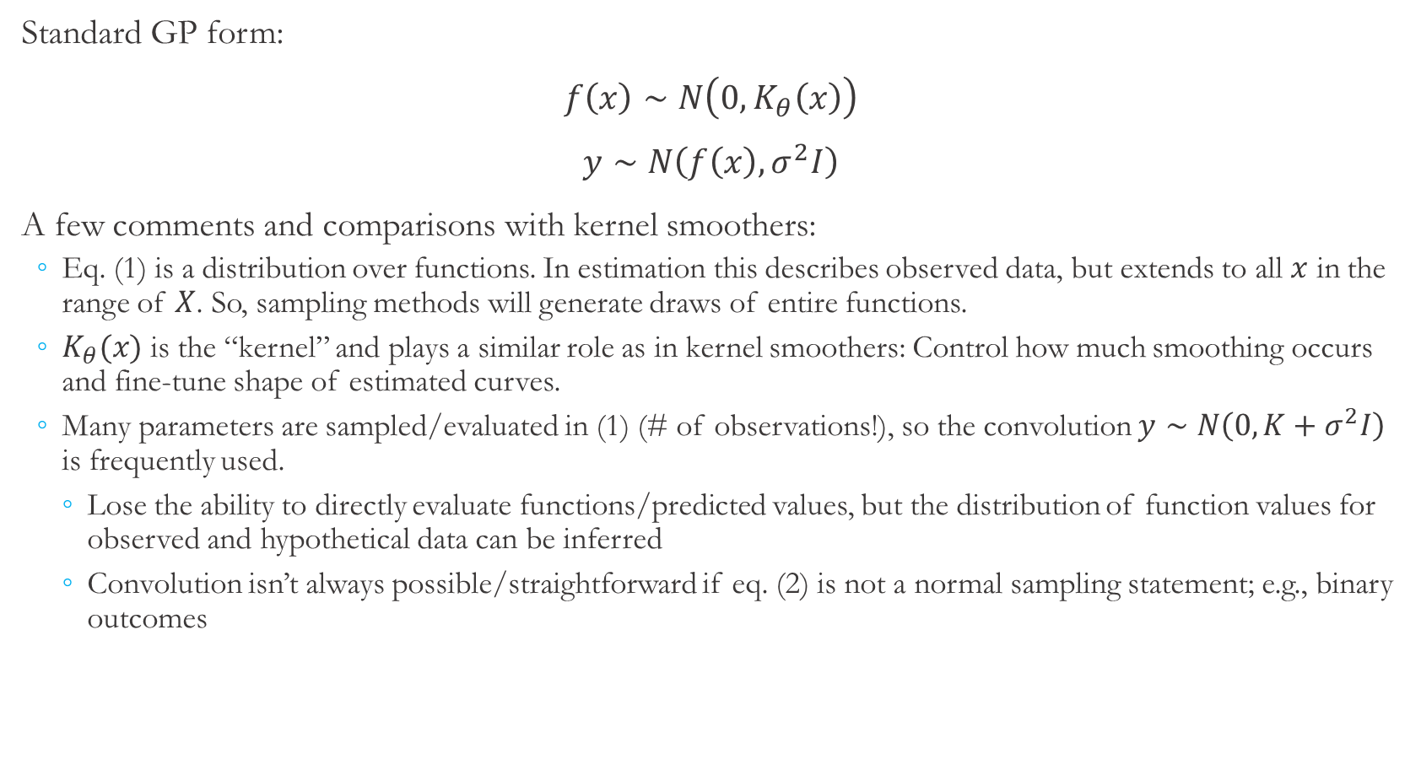
Gaussian Processes vs. Kernel Smoothers
Standard GP form:
$f\left(x\right)∼N\left(0,K_{θ}\left(x\right)\right)$
$y∼N\left(f\left(x\right), σ^{2}I\right)$
A few comments and comparisons with kernel smoothers:
Eq. (1) is a distribution over functions. In estimation this describes observed data, but extends to all $x$ in the range of $X$. So, sampling methods will generate draws of entire functions.
$K_{θ}(x)$ is the “kernel” and plays a similar role as in kernel smoothers: Control how much smoothing occurs and fine-tune shape of estimated curves.
Many parameters are sampled/evaluated in (1) (# of observations!), so the convolution $y∼N\left(0, K+σ^{2}I\right)$ is frequently used.
Lose the ability to directly evaluate functions/predicted values, but the distribution of function values for observed and hypothetical data can be inferred
Convolution isn’t always possible/straightforward if eq. (2) is not a normal sampling statement; e.g., binary outcomes
(1)
(2)
GP details

Slide 26
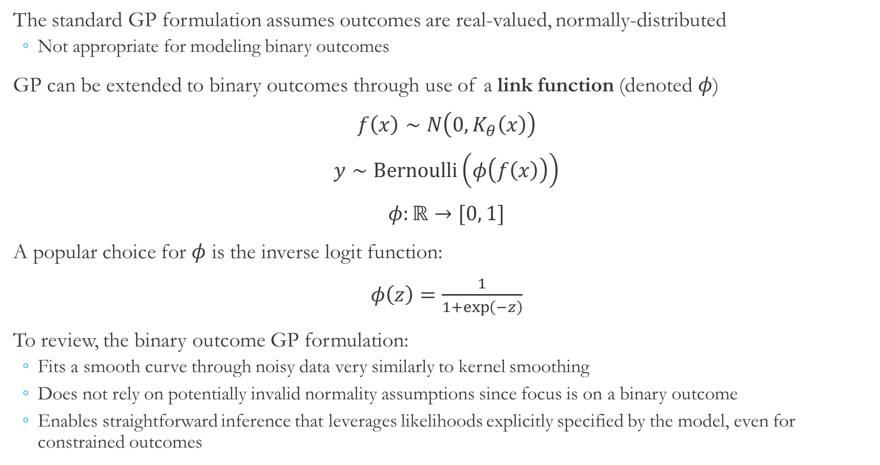
Gaussian Process for Binary Outcomes
The standard GP formulation assumes outcomes are real-valued, normally-distributed
Not appropriate for modeling binary outcomes
GP can be extended to binary outcomes through use of a link function (denoted $φ$)
$f\left(x\right)∼N\left(0, K_{θ}\left(x\right)\right)$
$y∼Bernoulli\left(φ\left(f\left(x\right)\right)\right)$
$φ:ℝ→[0, 1]$
A popular choice for $φ$ is the inverse logit function:
$φ\left(z\right)=\frac{1}{1+\exp\left(−z\right)}$
To review, the binary outcome GP formulation:
Fits a smooth curve through noisy data very similarly to kernel smoothing
Does not rely on potentially invalid normality assumptions since focus is on a binary outcome
Enables straightforward inference that leverages likelihoods explicitly specified by the model, even for constrained outcomes

Slide 27
Sampling Procedure
Inputs to emulation: Which actuator is targeted, what value(s) are injected to targeted actuator(s)
Output of emulation: Indicator of whether differential pressure exceeded 1 MPa at any point during the attack
Recall: Severe consequences can occur if differential pressure exceeds 1 MPa
We focus on estimating probability that differential pressure will exceed 1 MPa at any point in the two minute attack, conditional on which actuator is targeted and values injected to targeted actuator(s)
Input samples used to fit the GP were generated with Latin hypercube sampling
Generates a sample of inputs that effectively spans the input space
Sample contained 250 attack scenarios: 83 targeted heater, 83 targeted sprayer, and 84 targeted both
Emulation was run with each input sample and outcomes were recorded
Emulation initialized then allowed to stabilize for 5 minutes, followed by a 2 minute attack
Obtaining additional observations is relatively time-intensive, motivating

Slide 28
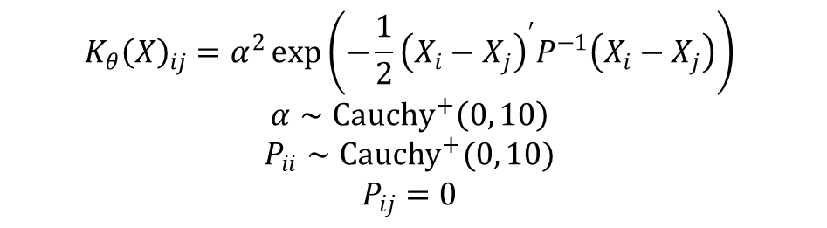
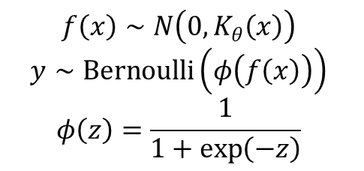
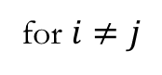
Estimation Issues and Procedure
Potential estimation issue: Binary outcome models can suffer from parameter instability, especially when using more flexible relationships between inputs and outcomes [?]
Can cause convergence issues for classical statistics estimation methods
Bayesian statistics estimation methods offer a solution
Must specify priors over parameters, but even weakly-informative priors can improve stability
Convergence can be assessed more reliably (e.g., trace plots/diagnostics)
Following Gelman et al. [?], half-Cauchy priors were assumed for kernel parameters
Relatively uninformative while maintaining a central tendency
Model was estimated using No U-Turn Sampling as implemented in the Stan platform
Sampler used 1000 burn-in and 1000 sampling iterations
Trace plots/diagnostics were used to assess convergence of Markov chain
$$f\left(x\right)∼N\left(0, K_{θ}\left(x\right)\right)$$
$$y∼Bernoulli\left(φ\left(f\left(x\right)\right)\right)$$
$$φ\left(z\right)=\frac{1}{1+\exp\left(−z\right)}$$
$$K_{θ}{\left(X\right)}_{ij}=α^{2}\exp\left(−\frac{1}{2}{\left(X_{i}−X_{j}\right)}^{′}P^{−1}\left(X_{i}−X_{j}\right)\right)$$
$$α∼Cauchy^{+}\left(0, 10\right)$$
$$P_{ii}∼Cauchy^{+}(0, 10)$$
$$P_{ij}=0$$
for $i≠j$

Slide 29
Results

Slide 30
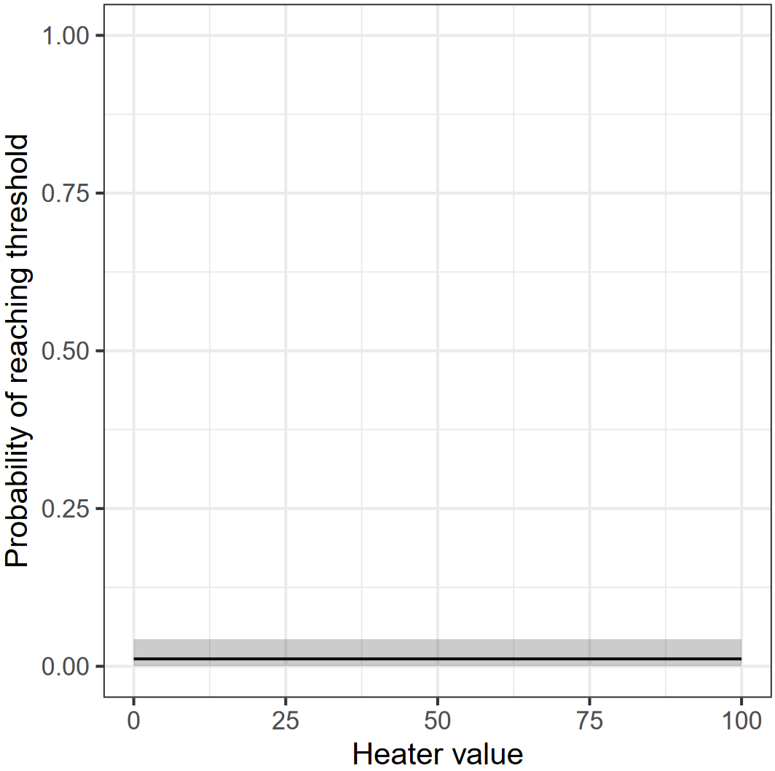
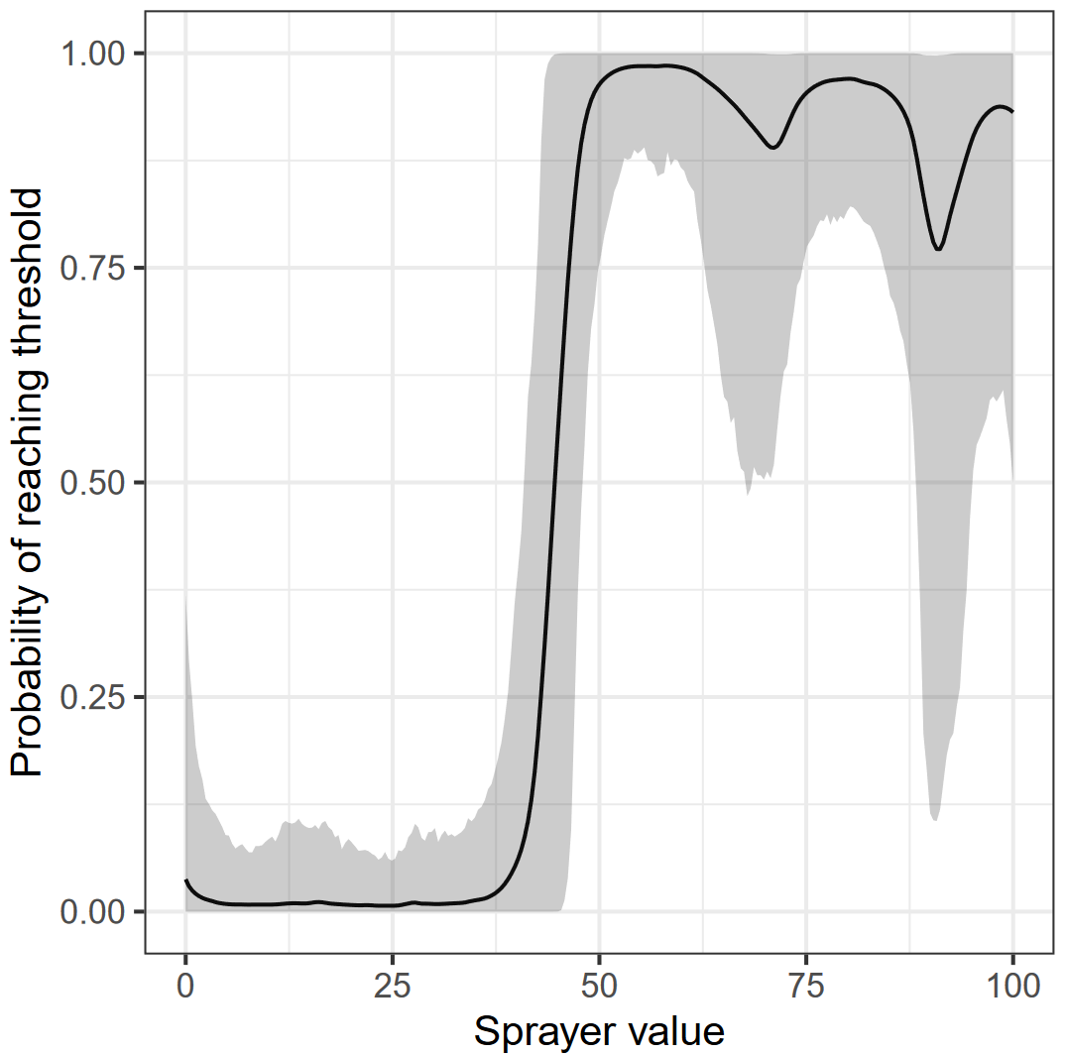
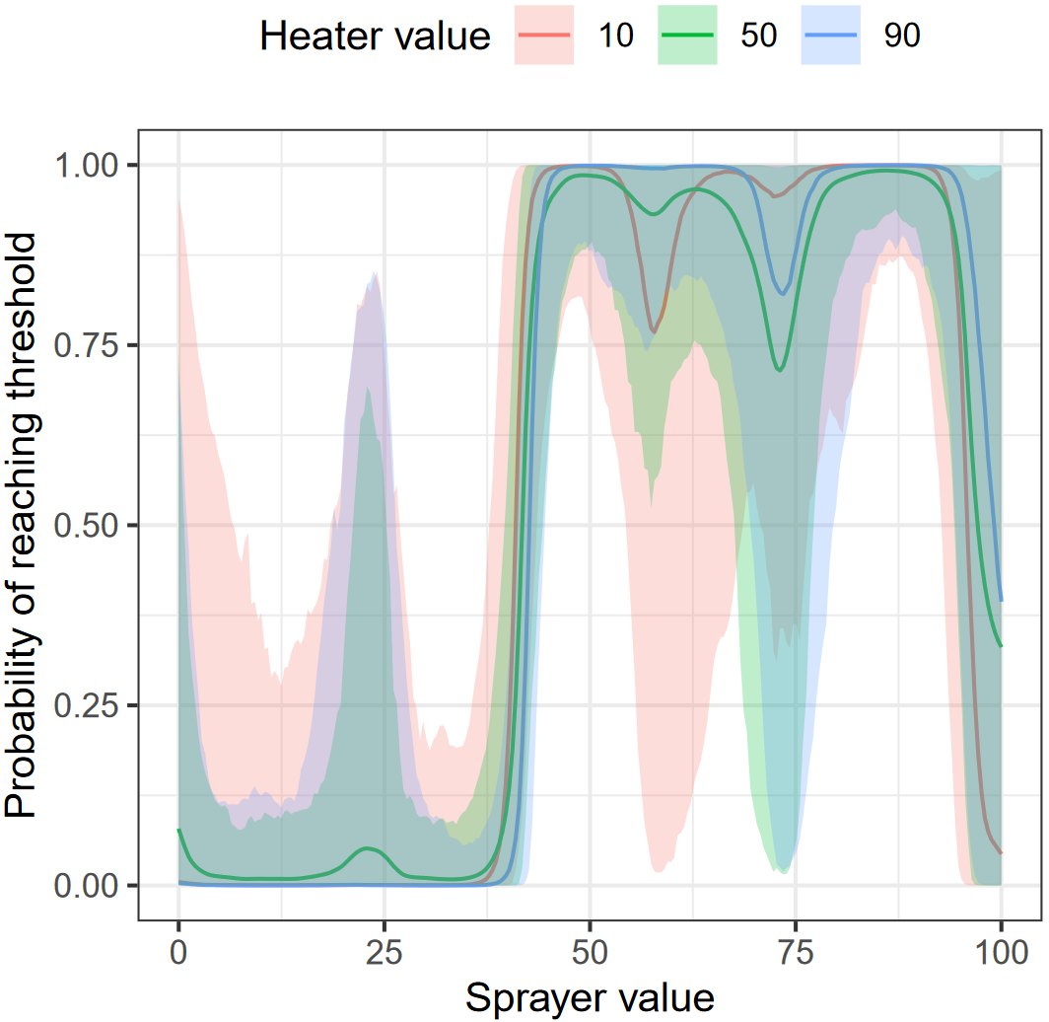
Conditional Probability Estimates
Probability of reaching 1 MPa threshold when only the heater actuator is targeted, conditional on values injected to heater actuator
Probability of reaching 1 MPa threshold when only the sprayer actuator is targeted, conditional on values injected to sprayer actuator
Probability of reaching 1 MPa threshold when both actuators are targeted, conditional on values injected to both actuators
Notes:
Next, we move to results. First, conditional probability estimates are shown on this slide. The left figure shows the probability of crossing the one mega-Pascal threshold if only the heater is targeted, middle shows if only sprayer is targeted, and right shows if both actuators are targeted. These figures begin to show some system behavior and avenues for possible mitigations. For example, it does not appear that the heater actuator plays a significant role, and the probability of crossing the threshold rises dramatically above sprayer values of about 40.
Bumps in the middle and right figure are due to iterations that did not result in crossing the one mega-Pascal threshold. These would indicate some overfitting, and we will discuss some ways to address in a couple slides.

Slide 31
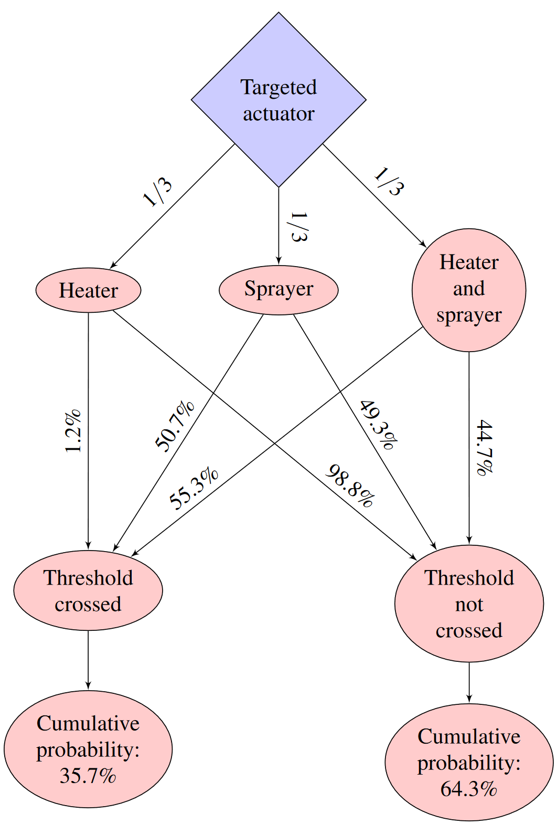
Overall Probability Estimates
Fitted GP surrogate function then used to estimate overall probability of crossing 1 MPa threshold
Heater actuator, sprayer actuator, and both actuators targeted with 1/3 probability each
Values injected to targeted actuator(s) uniformly distributed on [0, 100]
GP surrogate function provides computationally feasible method of approximating these probabilities
Each iteration of the emulation takes 5 minutes to set up/stabilize + 2 minutes for attack
Each sample of the GP takes ~0.7 seconds (3.5 GHz processor)
Notes:
We can also use the fitted Gaussian process surrogate function to estimate the overall probability of cross the one mega-Pascal threshold. Recall that the heater actuator, sprayer actuator, and both actuators are each targeted with probability 1/3, and values injected to targeted actuators are uniformly distributed on the interval from 0 to 100. The event tree and results are shown in the figure on the right. Overall, given assumptions about the attack, we estimate there is a 35.7% probability the threshold will be crossed given the attack occurs.
Using a Gaussian process surrogate function makes it computationally feasible to approximate these probabilities. To illustrate, each iteration of the emulation takes five minutes to set up and stabilize and an additional two minutes for the attack.
On the other hand, each sample of the Gaussian process takes about 0.7 seconds.

Slide 32
Discussion and Impacts

Slide 33
Methodological Extensions
Investigation of alternative surrogate functions, including goodness-of-fit measures
Alternative forms of GP model
Imposition of constraints such as monotonicity
Alternative correlation structure in outcomes; e.g., relationship between outcomes when only sprayer actuator is targeted vs. when both actuators are targeted
Alternative sampling methodologies to boost efficiency of surrogate functions
Extension to real-valued outcomes
Preliminary results indicate some outcomes may be distinctly non-normal and standard methods may not apply
Notes:
While this research illustrates one method to perform uncertainty quantification on a cyber experiment with noisy outcomes, there are several extensions that could be pursued.
First, this research only considers a Gaussian process surrogate function. There are many other choices of surrogate functions available that one could compare with, for example, goodness-of-fit metrics.
There are also alternative forms of the Gaussian process model that could be considered. Additional constraints like monotonicity could be imposed, and alternative correlation structures could be explored.
While this research used Latin hypercube sampling to generate data to fit the surrogate function, other sampling methodologies could yield greater efficiency.
Finally, this research focused on a binary outcome but could also be used to describe real-valued outcomes. Our preliminary results indicate some outcomes may be distinctly non-normal (such as Cauchy distribution), so standard methods may need to be adjusted to be applicable.

Slide 34
Impacts
Lessons learned and informing UQ cyber emulation analyses for other applications
Assumptions supporting asymptotics may not be valid for real-valued outcomes. Methods that avoid asymptotics are preferable (possibly necessary). Candidates include Gaussian processes and bootstrapping.
Reframing outcomes can be useful to avoid difficult distributional assumptions and simplify analysis
E.g., can real-valued outcomes be transformed into binary/categorical indicators and still capture important information?
This proof-of-concept model was extended to be more representative of actual PWR systems, directly useful to DOE-NE sponsor
Incorporate intrusion detection/mitigation into SCADA network
Utilize previous threat/vulnerability analyses and intelligence to develop more sophisticated/realistic distribution of attacks

Slide 35
Acknowledgements
Thanks to Eric Vugrin, Robert Bruneau, Meg Galiardi, Amanda Gonzales, Jamie Thorpe, Ray Fasano, Tim Ortiz, and Ryan Kao
Work made possible by funding from DOE-NE Cyber Security for Nuclear Facilities
Notes:
We would like to thank Eric Vugrin and Robert for their leadership and thoughtful suggestions, Meg Galiardi, Amanda Gonzales, and Jamie Thorpe for their help with our UQ experiments, Ray Fasano for the PWR Simulink model and model description, and Tim Ortiz and Ryan Kao for the minimega model of the cyber system.
Finally, this work was made possible by funding from DOE-NE Cyber Security for Nuclear Facilities.

Slide 36
References
[1] McKenzie, Taylor, Ch
[2] SCEPTRE one-pager
[3] U.S. Nuclear Operating Plant Basic Information

Slide 37
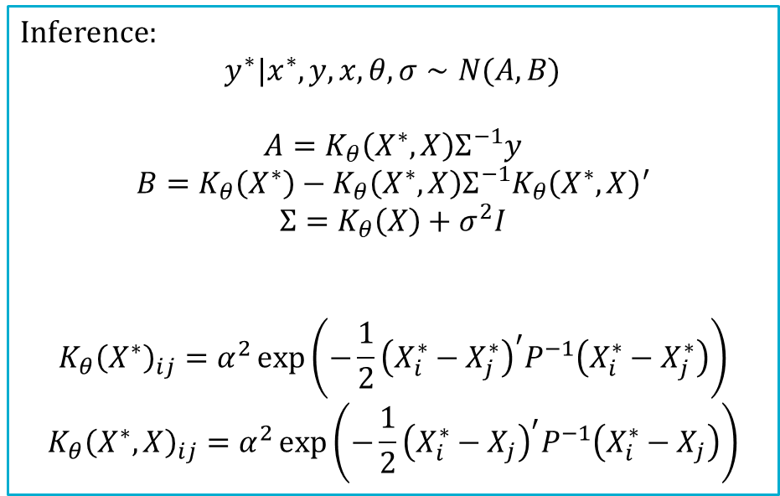
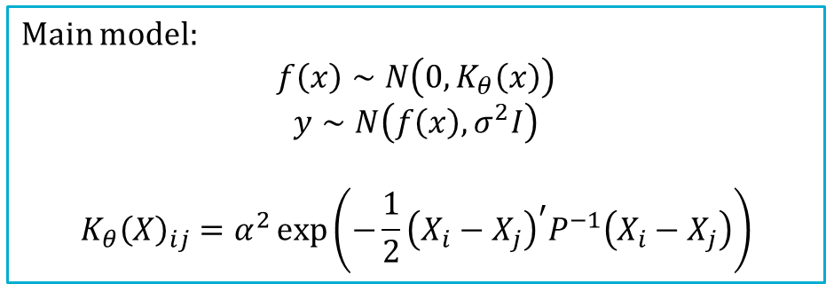

Gaussian Process Details
Main model:
$$f\left(x\right)∼N\left(0,K_{θ}\left(x\right)\right)$$
$$y∼N\left(f\left(x\right), σ^{2}I\right)$$
$$K_{θ}{\left(X\right)}_{ij}=α^{2}\exp\left(−\frac{1}{2}{\left(X_{i}−X_{j}\right)}^{′}P^{−1}\left(X_{i}−X_{j}\right)\right)$$
Inference:
$$y^{∗}|x^{∗},y,x,θ,σ∼N(A, B)$$
$$A=K_{θ}\left(X^{∗},X\right)Σ^{−1}y$$
$$B=K_{θ}\left(X^{∗}\right)−K_{θ}\left(X^{∗}, X\right)Σ^{−1}K_{θ}{\left(X^{∗}, X\right)}^{′}$$
$$Σ=K_{θ}\left(X\right)+σ^{2}I$$
$$K_{θ}{\left(X^{∗}\right)}_{ij}=α^{2}\exp\left(−\frac{1}{2}{\left(X_{i}^{∗}−X_{j}^{∗}\right)}^{′}P^{−1}\left(X_{i}^{∗}−X_{j}^{∗}\right)\right)$$
$$K_{θ}{\left(X^{∗},X\right)}_{ij}=α^{2}\exp\left(−\frac{1}{2}{\left(X_{i}^{∗}−X_{j}\right)}^{′}P^{−1}\left(X_{i}^{∗}−X_{j}\right)\right)$$
(1)
(2)
Dimension reduction using convolution:
(1) + (2) $⇒$
$$y∼N\left(0, K_{θ}(x)+σ^{2}I\right)$$
Return to main presentation

Slide 38
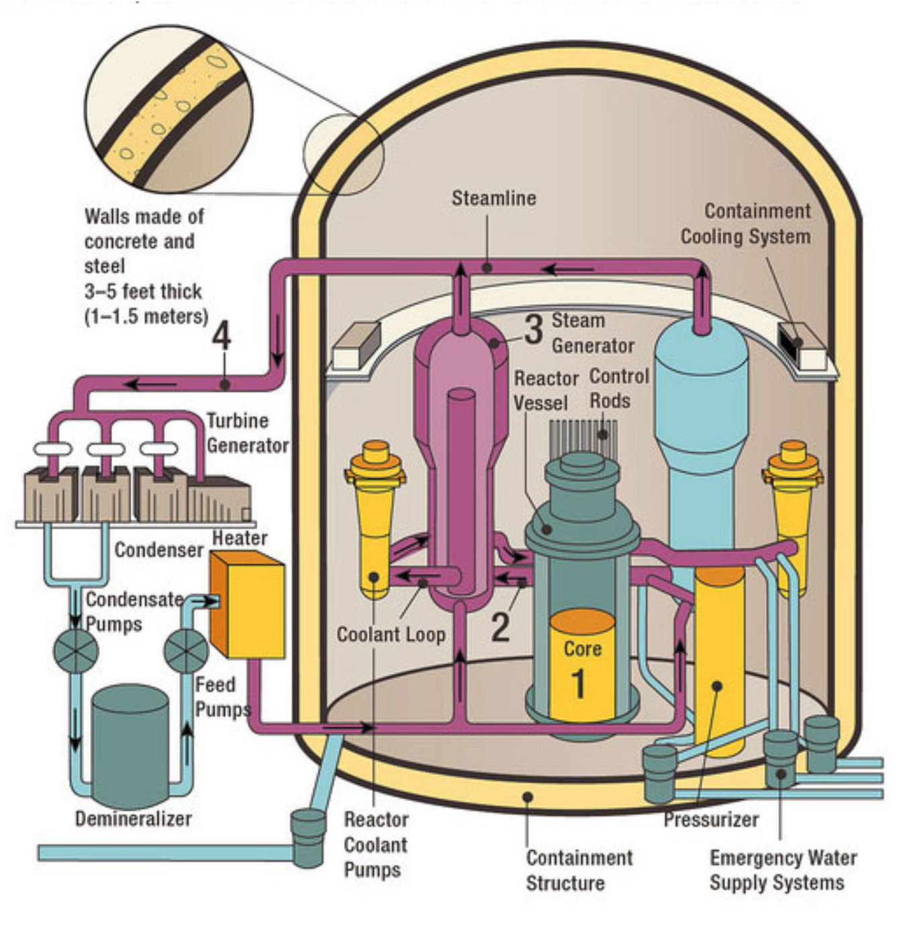
Proof of Concept System: Pressurized Water Reactor (PWR)
Image source: NRC

Slide 39
Uncertainty Quantification With Surrogate Functions
Monte Carlo analysis can be used as a basic form of UQ
Draw sample of input parameters from specified distributions.
Evaluate emulation and store outcomes.
Repeat many times to approximate distributions of outcomes.
Cyber experiments are frequently computationally-intensive
It is often infeasible to evaluate emulation enough times to adequately approximate outcome distributions
Surrogate functions can be used to reduce computational burden at the cost of introducing uncertainty
Surrogate function process:
Emulation is evaluated a small (feasible) number of times over the parameter space.
A surrogate function mapping parameter space to outcome space is fit using evaluations from (1).
Generation of outcome distribution using the surrogate function from (2).
Notes:
Now, to give a commonly used example, Monte Carlo analysis is a basic form of UQ. In that procedure, a sample of inputs is drawn, the emulation is run and outcomes are collected, and the process is repeated many times to approximate outcome distributions.
As with many other applications, cyber experiments are often computationally-intensive, making it infeasible to evaluate the emulation enough times to adequately approximate outcome distributions.
In this case, surrogate functions are often used to reduce computational burden, at the cost of introducing some additional uncertainty.
The surrogate function process begins by evaluating the emulation a relatively small number of times across the parameter space. The surrogate function from the parameter space to the outcome space is then fit using those observations, and that surrogate function can then be used to generate predictions of outcome distribution more quickly than re-running the emulation.

